Slide 1
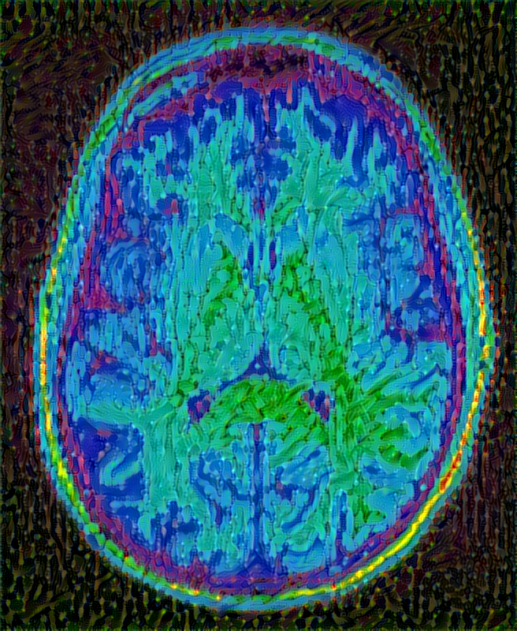
Brain Lovers

Slide 2
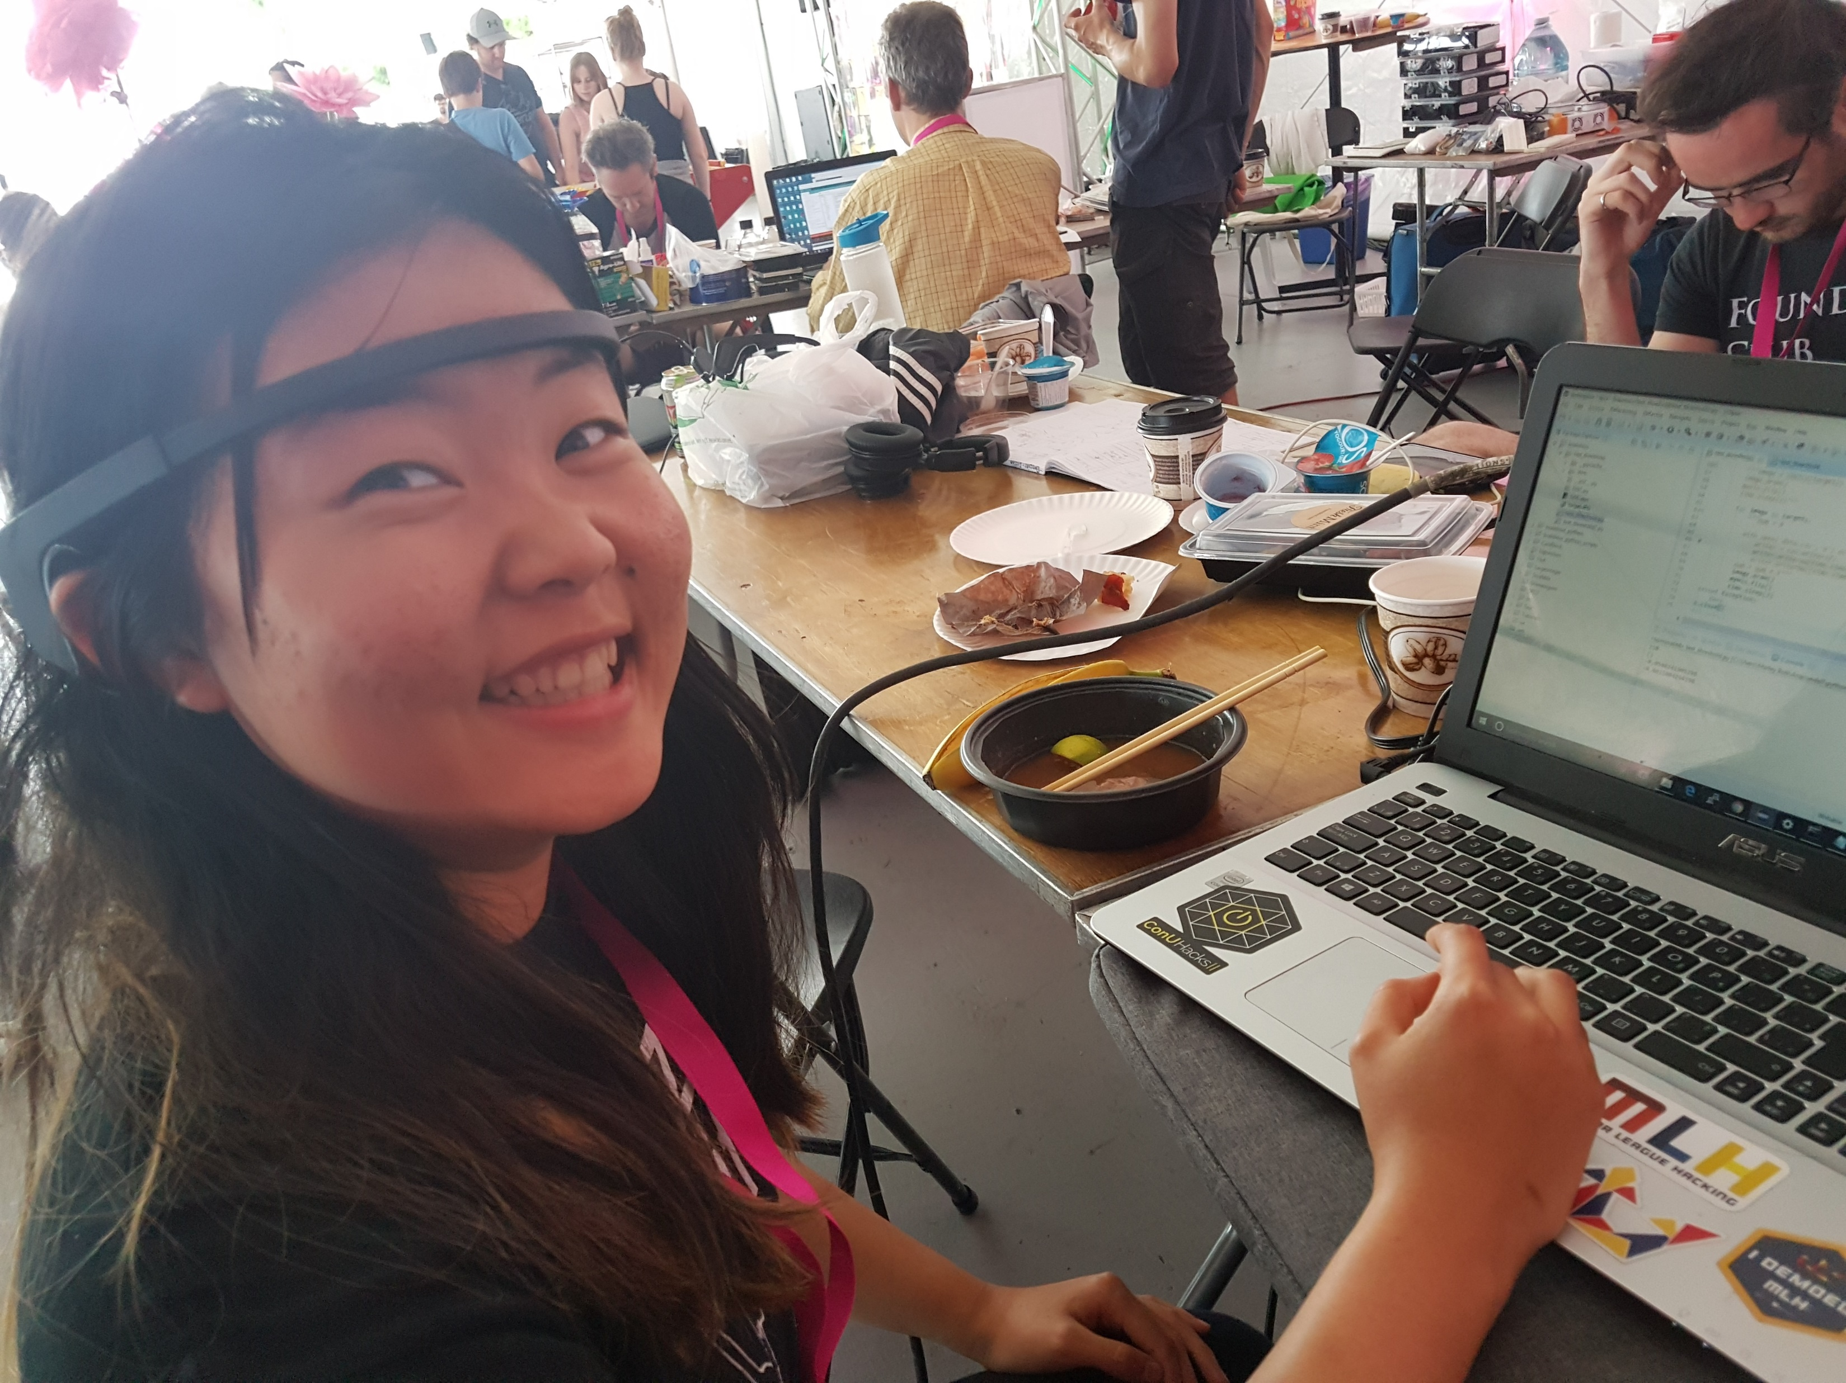
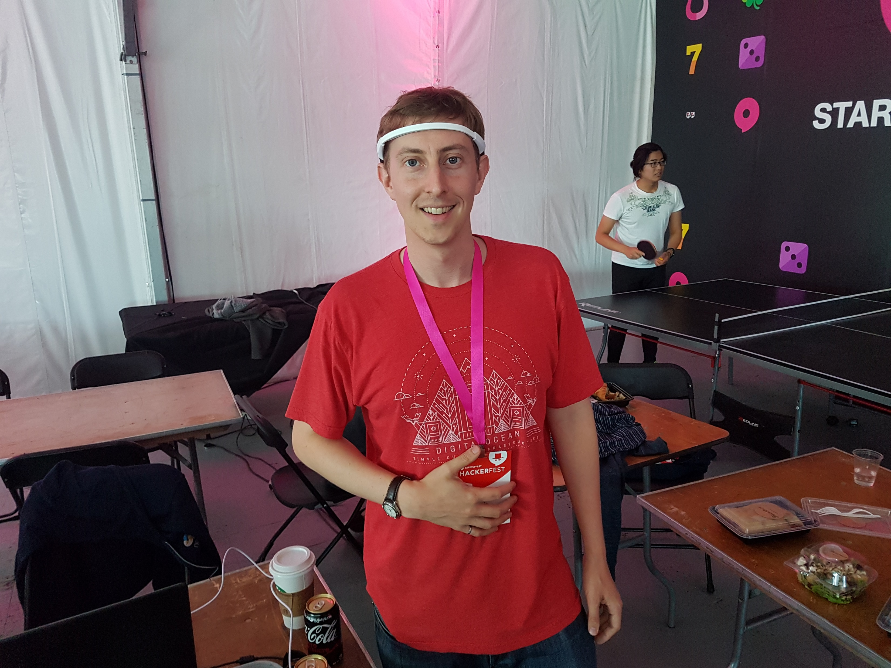
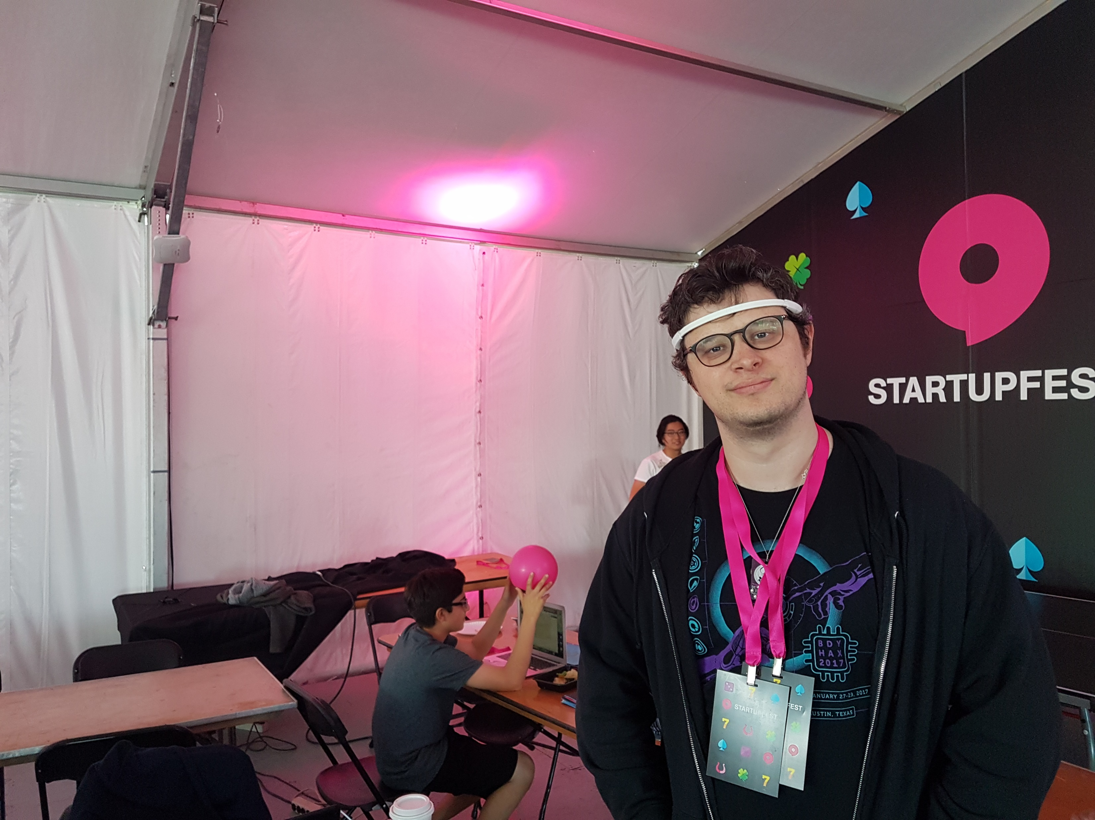
The Team
Marley Xiong
Andrew Doyle
Sydney Swayne-Simon

Slide 3
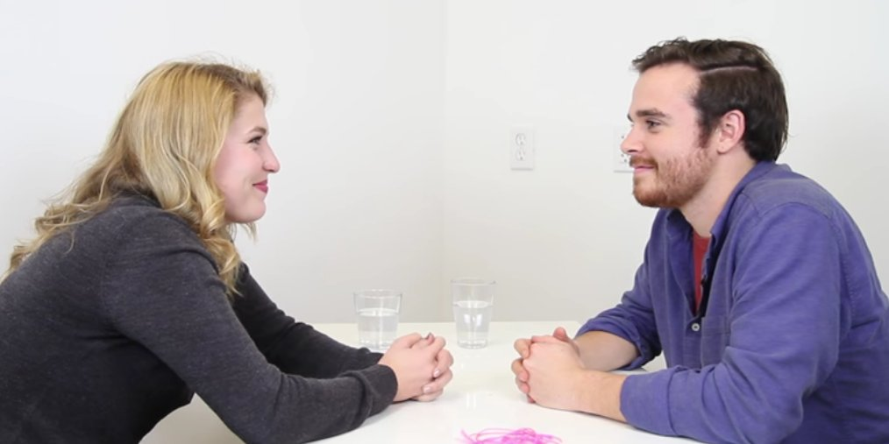
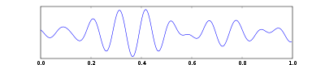
The Dream

Slide 4
The Science
Lovers’ α waves (8-14 hz) synchronize when they stare into each others’ eyes

Slide 5
The Science
Lovers’ α waves (8-14 hz) synchronize when they stare into each others’ eyes
Frontal α asymmetry can be used to detect interest
Interest Score:
$$interest=\log{α_{left} −\log{α_{right}}}$$

Slide 6
The Experiment
DEMO TIME

